Slide 1
Task 1
Internship Studio’s Ethical Hacking Internship
Name : Deep Kakadiya
E-mail: imyourdad0120@gmail.com

Slide 2
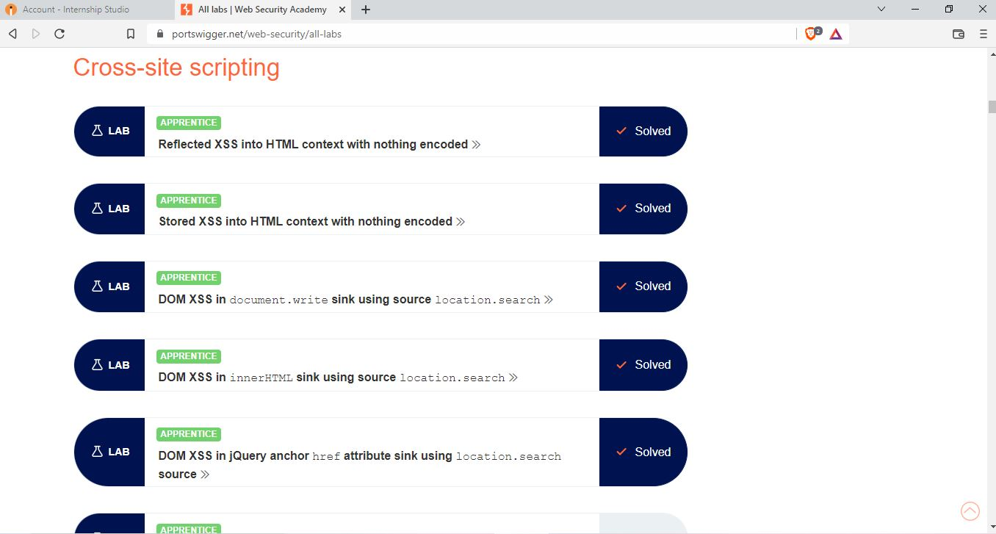

Slide 3
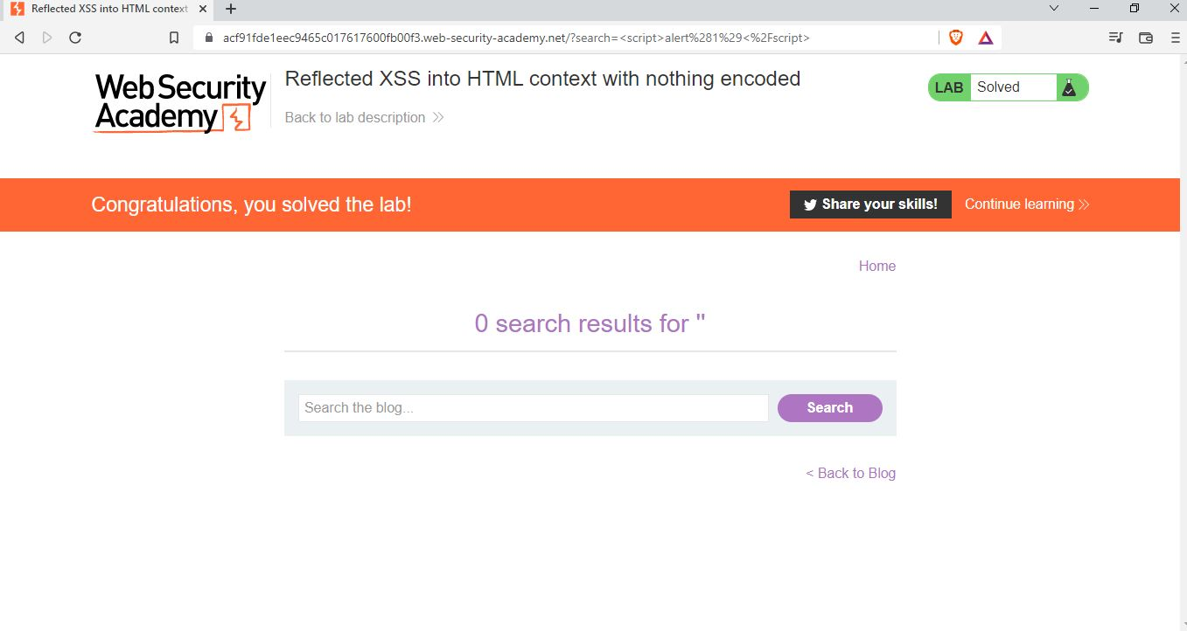

Slide 4
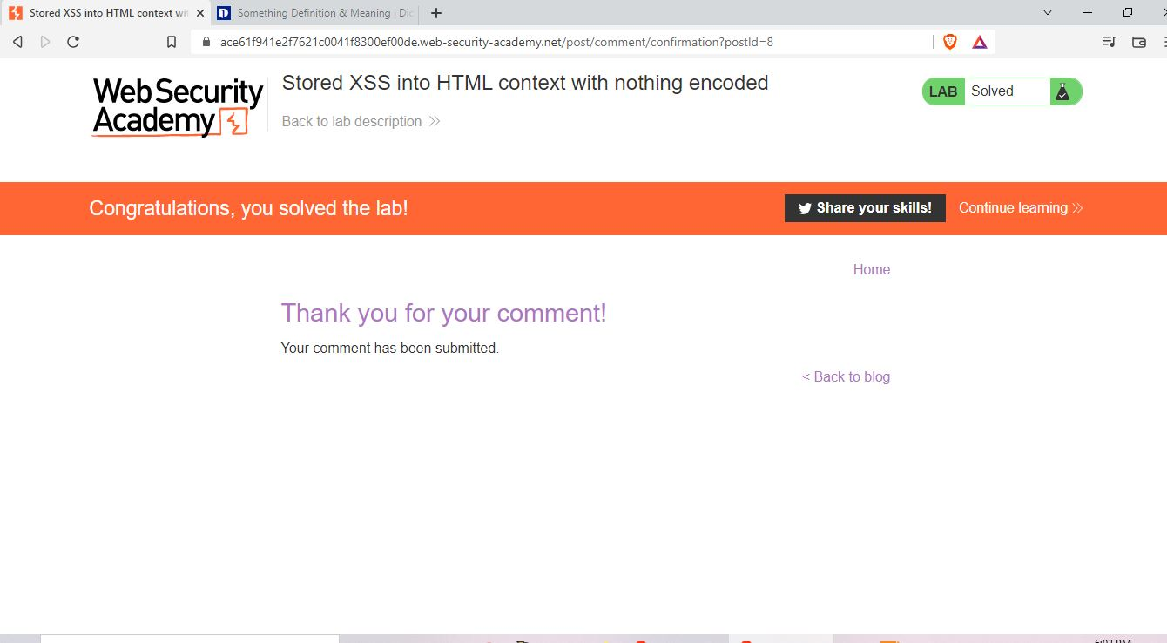

Slide 5
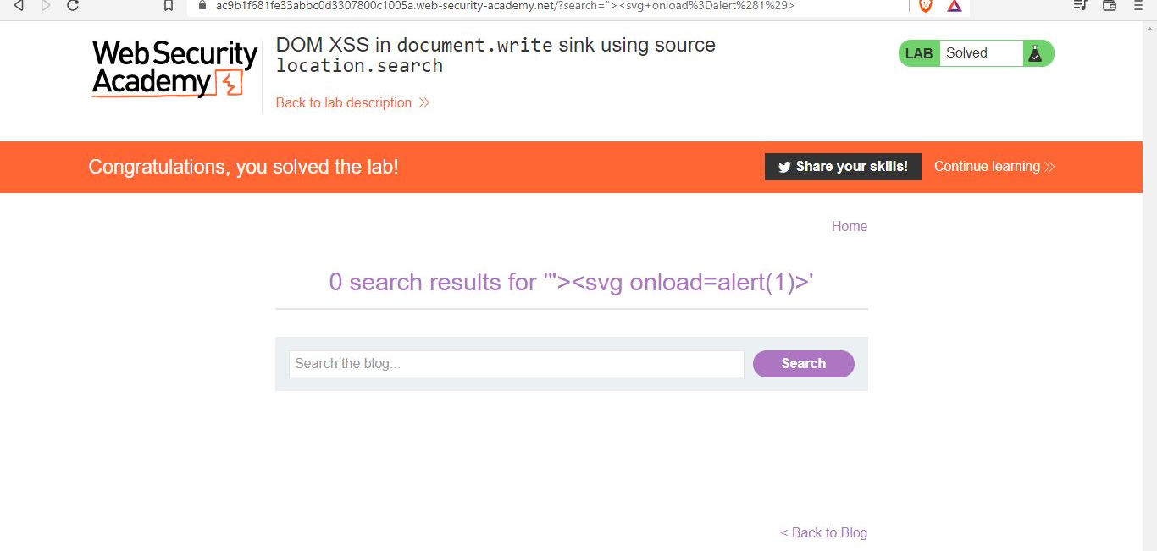

Slide 6
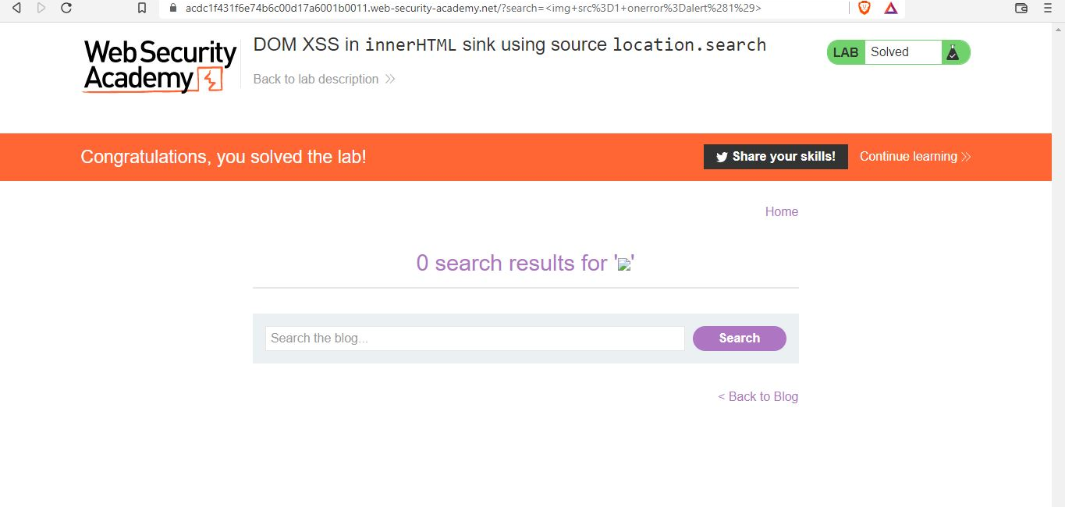

Slide 7
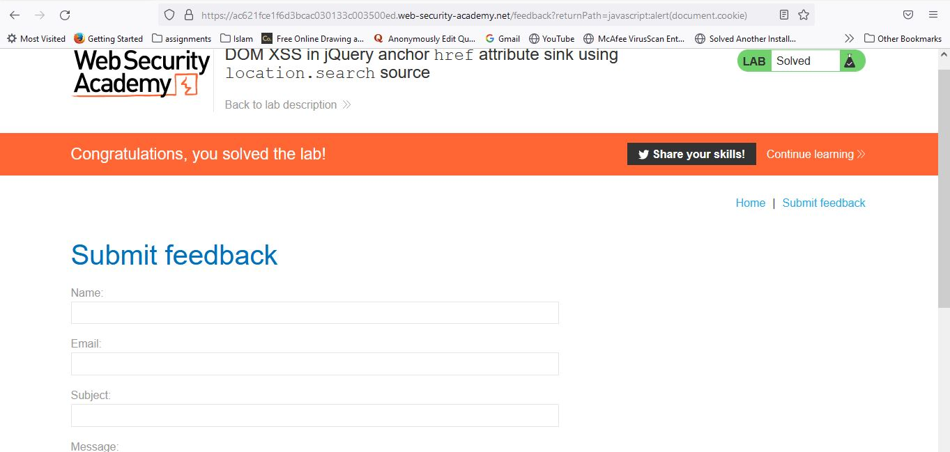

Slide 8
THANK YOU

